Slide 1
LIME Replication
叶如锐 周韬 叶宇翔 陈晨阳

Slide 2
Abstract
Lime introduction
Replication

Slide 3
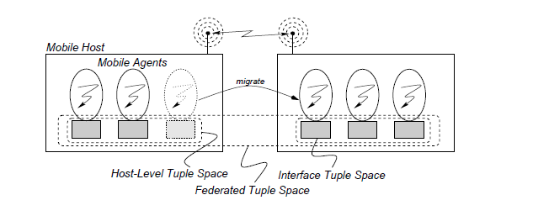
Overview

Slide 4
Tuple
_fields ------> Vector
_formal------> Vector
Formal
Template:
hello
String.class
Hello.class
Field:
hello
you
asdf
addActual()
Notes:
如果Template是值，则要值和Type都一样
如果是Type，则只要Type一样

Slide 5
Tuplespace
LimeTupleSpace
LimeSystemTupleSpace

Slide 6
LimeTupleSpace
the most basic component of a Lime-based application
interacts with the rest of the world
Operations
Shared Control
Out,in
Reaction

Slide 7
LimeSystemTupleSpace
Specifies reactions that are concerned only over the Lime System Tuple Space.
Tuple Format
<_host, LimeServerID>
<_host_gone, LimeServerID>
<_agent, agentID, LimeServerID>
<_agent_gone, agentID, LimeServerID>
<_tuplespace, tsname, agentID>
<_tuplespace_gone, tsname, agentID>

Slide 8
Reaction
LocalizedReaction
Action of TupleSpace
current and destination locations,template all match
LimeSystemReaction
Action of LimeSystemTupleSpace

Slide 9
Replacation
LImeTuple
ReplicableTuple
VersionedTuple
Data

Slide 10
Tuple Extand
<data> → <origCur , origDest , isReplica, data>
<data> → <tupleID, versNum, data>
<data>->LimeTuple

Slide 11
Acctions
Replication mode
MASTER :
The first replica must be made from the master
ANY
The first replica can be made from any tuple

Slide 12
Actions
Consistency Mode
NEVER
Replicas must never be updated
MASTER
Replicas must only be updated from their master
ANY
Replicas can be updated from any newer version

Slide 13
Implement
public ReplicableTuple change(ReplicableTemplate p, ITuple t);
----->update?
public RegisteredReplicaRequest addReplicaRequest(LimeTemplate p,int replicationMode,int consistencyMode);
public void removeReplicaRequest(RegisteredReplicaRequest r);

Slide 14
Questions
What Kind of template to use for replication
How the reactions work
What format to store the replicas

Slide 15
Thank You

